Slide 1
Cansat in Russia
Team KYYRAI
Performed by student of 11th grade
Popov Vladimir
Teacher: Nyurgun Maratovich
Yakutsk city - 2019

Slide 2
Designer
Satellite Cansat consists of:
Mechanical frame
Three boards
Charge MK Atmega128
Board of science load (temperature sensor, pressure and accelerometer.
Board of radio-module(transceiver) , frequency – 2,4 -2,525 GHz.

Slide 3
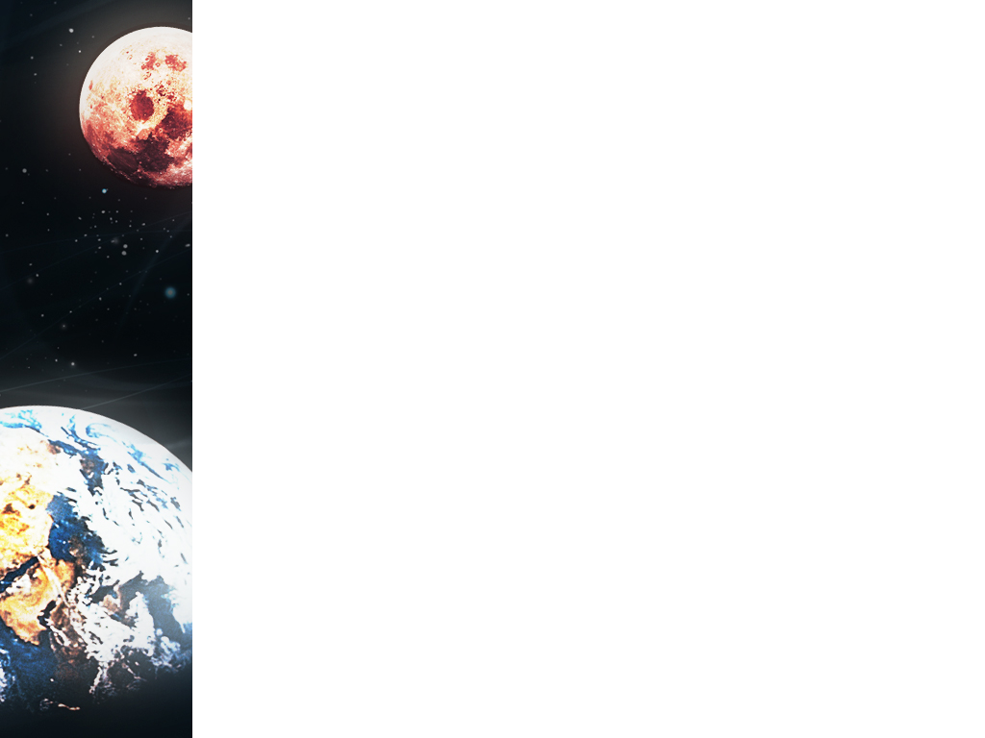
Missions of my spacecraft
My main mission is a ecological monitoring.
I will be watching the concentration of dust in the air.
My device measures the amount of dust in the air (mg/m^3)
I want to make our city ecologically safe.

Slide 4
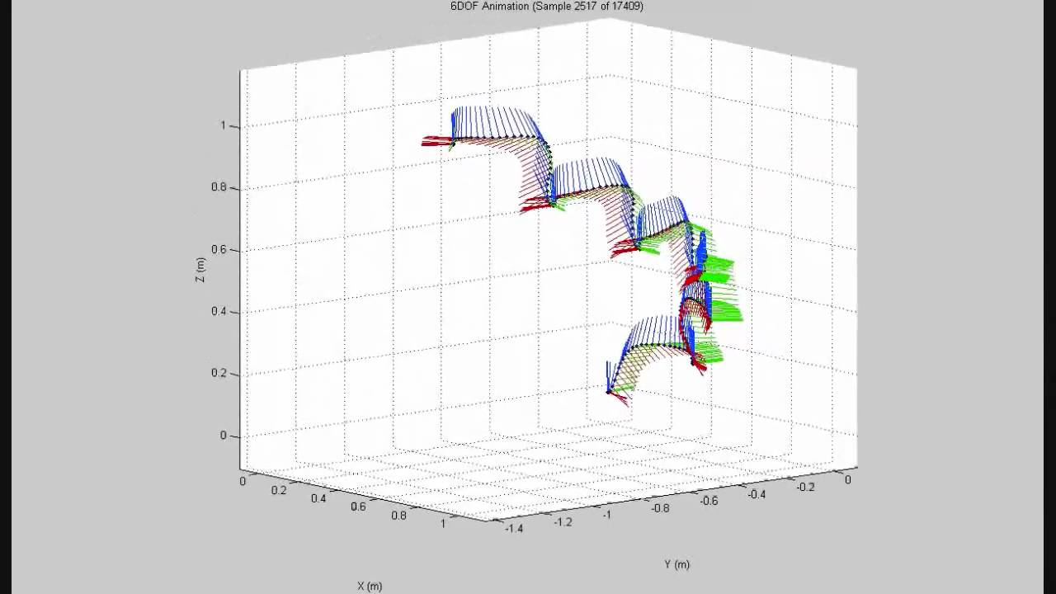
Our missions:
Measurement of temperature and pressure on the descent path.

Slide 5
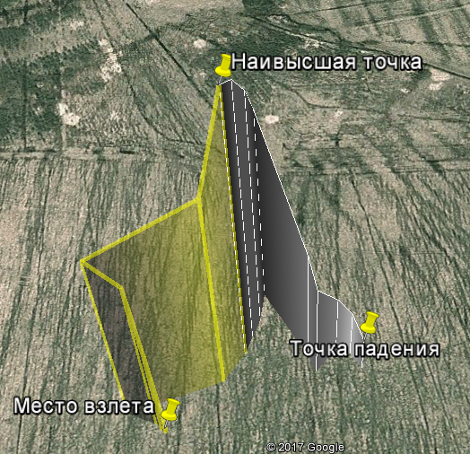
Our missions:
2. Data acquisition and interpretation with 3-axis accelerometer.

Slide 6
3. Construction of the trajectory of the satellite descent from the data obtained.

Slide 7
4. Humidity measurement

Slide 8
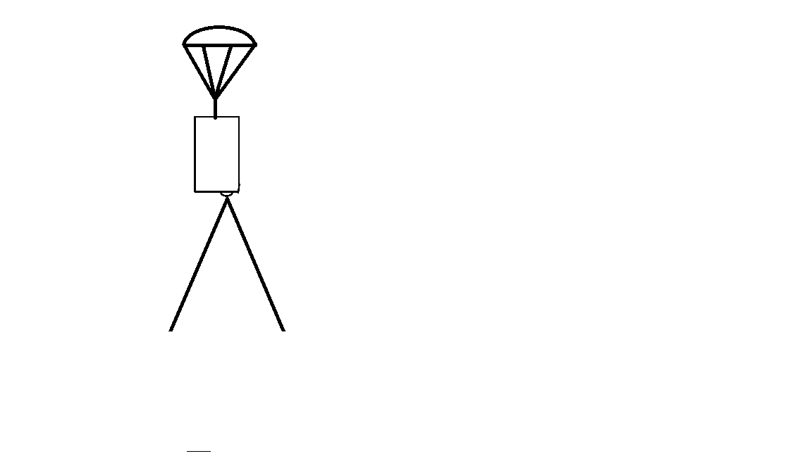
5. Surveying the area

Slide 9
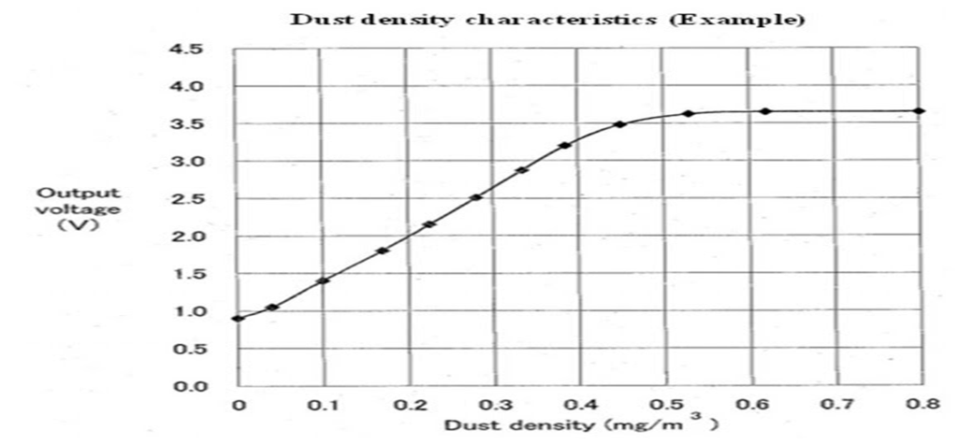
6. Measuring the amount of dust

Slide 10
7. Transmissions of telemetry over the radio channel to the ground receiving station.

Slide 11
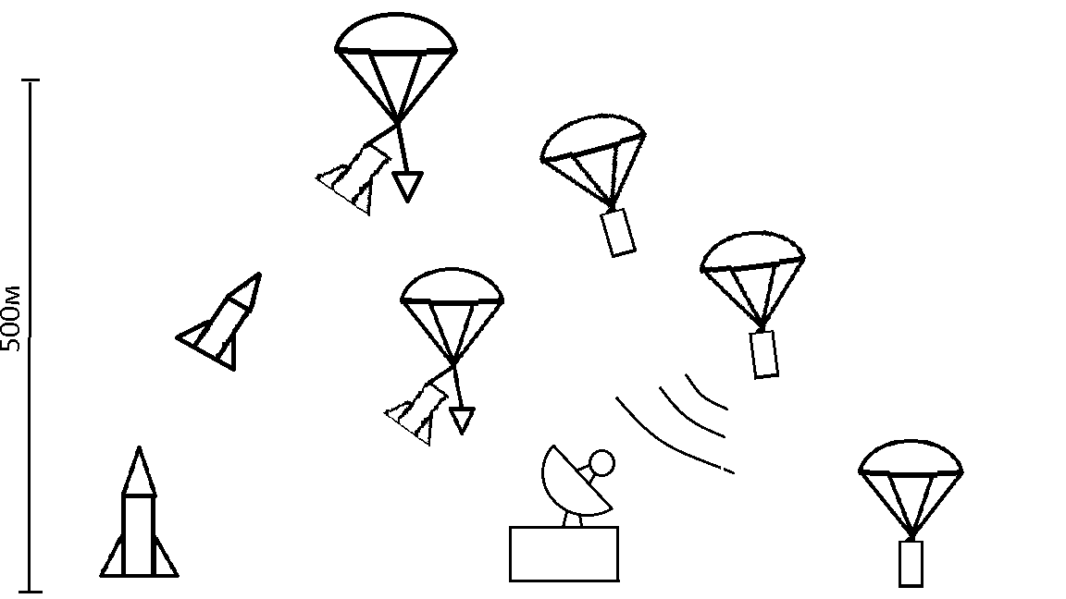
Flight diagram

Slide 12
The block-diagram of the satellite:
Data
Power
Gps-module
Microcontroller
(Atmega128)
Camera
Battery
Press/Temp
Ground station
receiver
Accelerometer
antenna
antenna
receiver
Dust sensor
PC

Slide 13
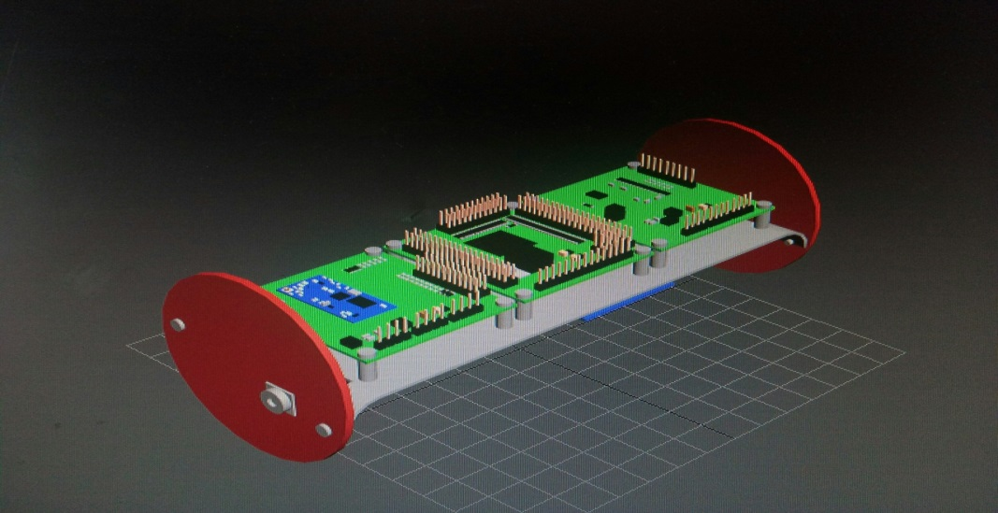
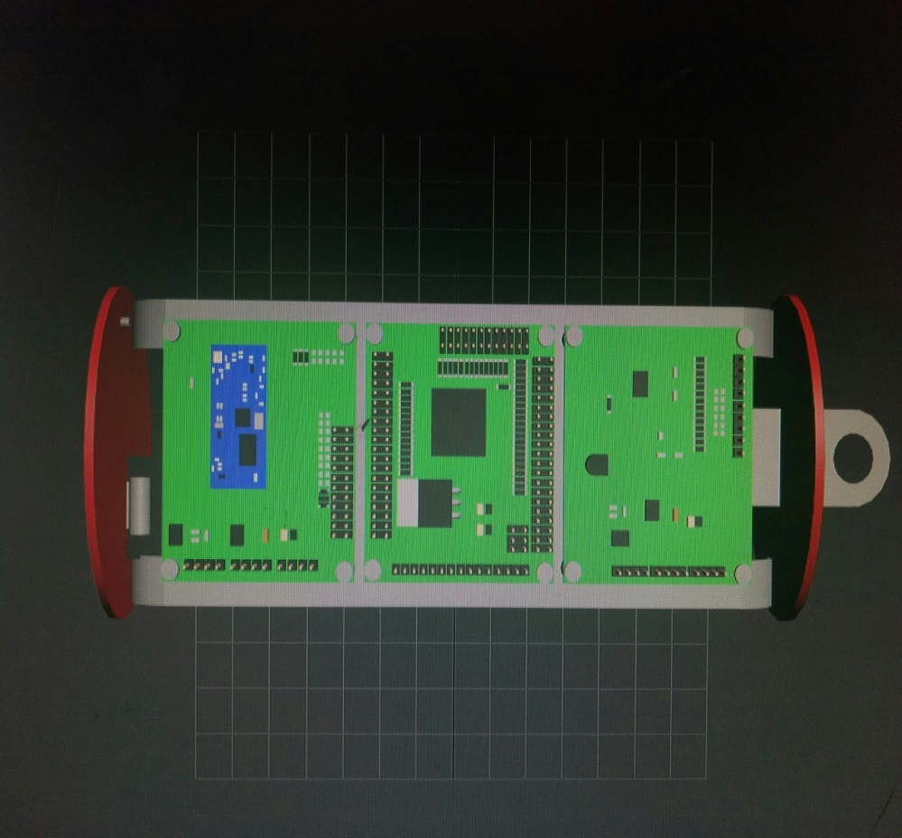
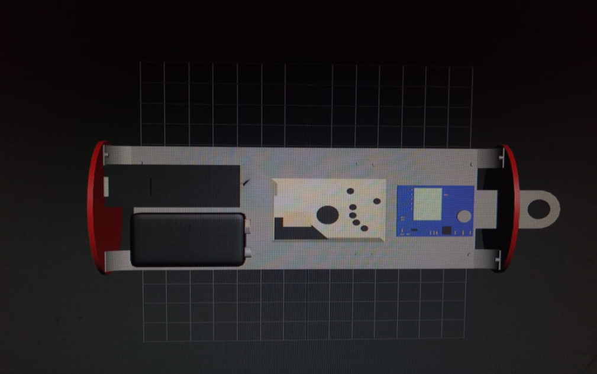
Project work
Camera lens
MK board Atmega128
Radio module board
Sensor board
GPS-module
Dust sensor
Battery
Camera

Slide 14
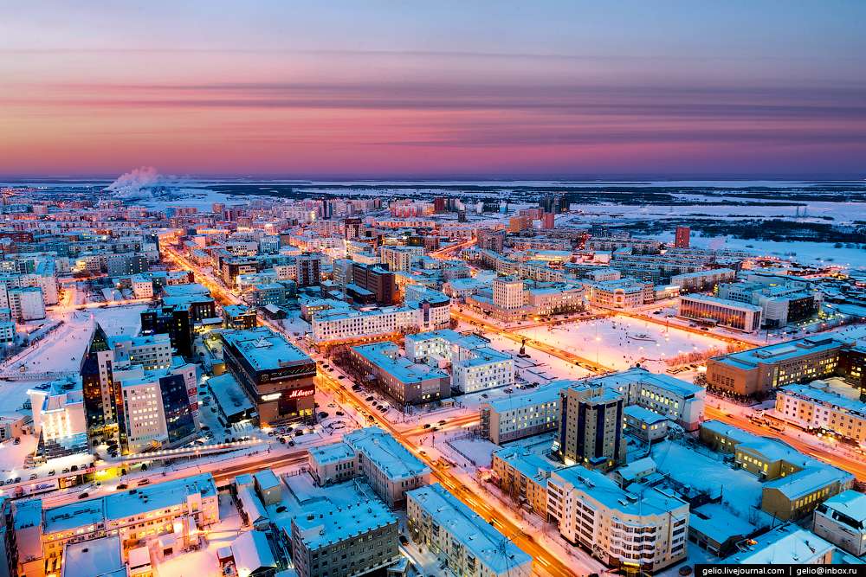
Monitoring of dust concentration:
X
Y
F
Z
W

Slide 15
What we used:
We use C language for programming our device.
Our device differs from the standart in that it has a built-in dust sensor, camera and Gps-module.

Slide 16
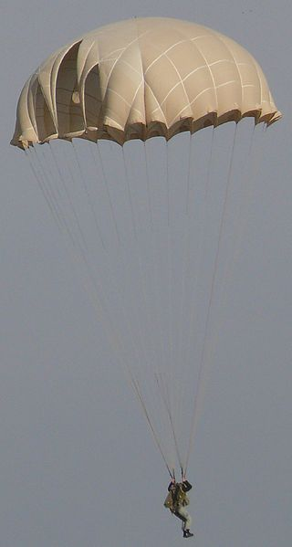
System of safety:
Fc=mg-ma
r
Hemisphere type system of safety
F= the force of air resistance
r = radius of parashute
F=mg

Slide 17
The calculation of the parachute canopy:
m=0.35 кг – масса аппарата
g=9.8 м/с2 - ускорение свободного падения
cd=1.2– коэффициент сопротивления
ρ=1.2754 кг/м3 – плотность воздуха
v=8 м/с – скорость спуска
r= 15 см – радиус основания парашюта.
D= 30 см – диаметр парашюта.
F- сила сопротивления воздуха.
.
Hemisphere type system of safety

Slide 18
Устройство | Напряжение (В) | Сила тока (А) | Мощность (Вт)
GPS NEO-6M | 3,30 | 0,10 | 0,33
BMP280- | 5,00 | 0,00 | 0,01
GP2Y1010AU0F | 5,00 | 0,02 | 0,10
DS18B20 | 5,00 | 0,00 | 0,01
Atmega128 | 5,00 | 0,02 | 0,10
ADXL345- | 3,60 | 0,00 | 0,00
E01-ML01SP2 | 3,60 | 0,02 | 0,10
DHT11 | 5,00 | 0,20 | 0,10
Итог |  |  | 0,75

Slide 19
What we used:
We use C language for programming our device.
Our device differs from the standart in that it has a built-in dust sensor, camera and Gps-module.

